Slide 1

Arduino/C++ Workshop
ECU Robotics Society – Keegan Barnard, Jessica Dippenaar

Slide 2
Today’s Session - Tuesday
9am-11am Using Simple Servo, Pushbutton, Joystick, Tilt Switch
11am-12pm, Controlling a DC motor, Tilt switch cut off with DC motor
12pm-12.30pm, Lunch
1pm-3pm, Controlling DC motor speed with Joystick and direction with push buttons

Slide 3
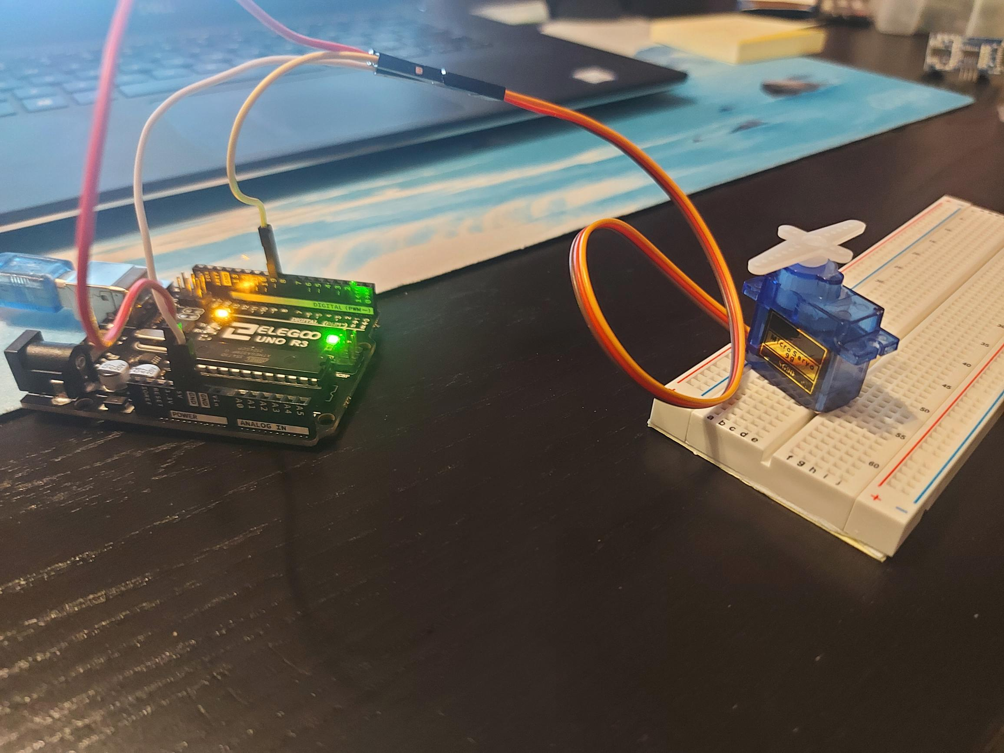
Servo Motor
Using User input to manually change the position of a servo motor

Slide 4
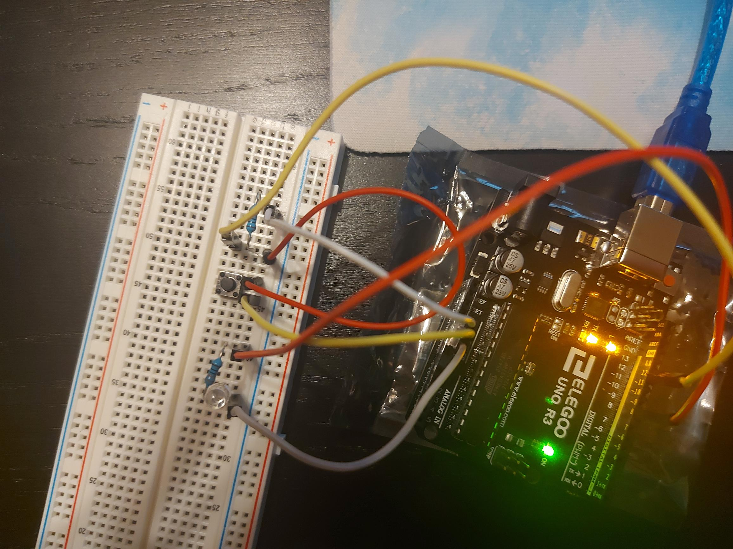
Pushbutton
Uses one pushbutton switch to control an LED to turn on/off

Slide 5
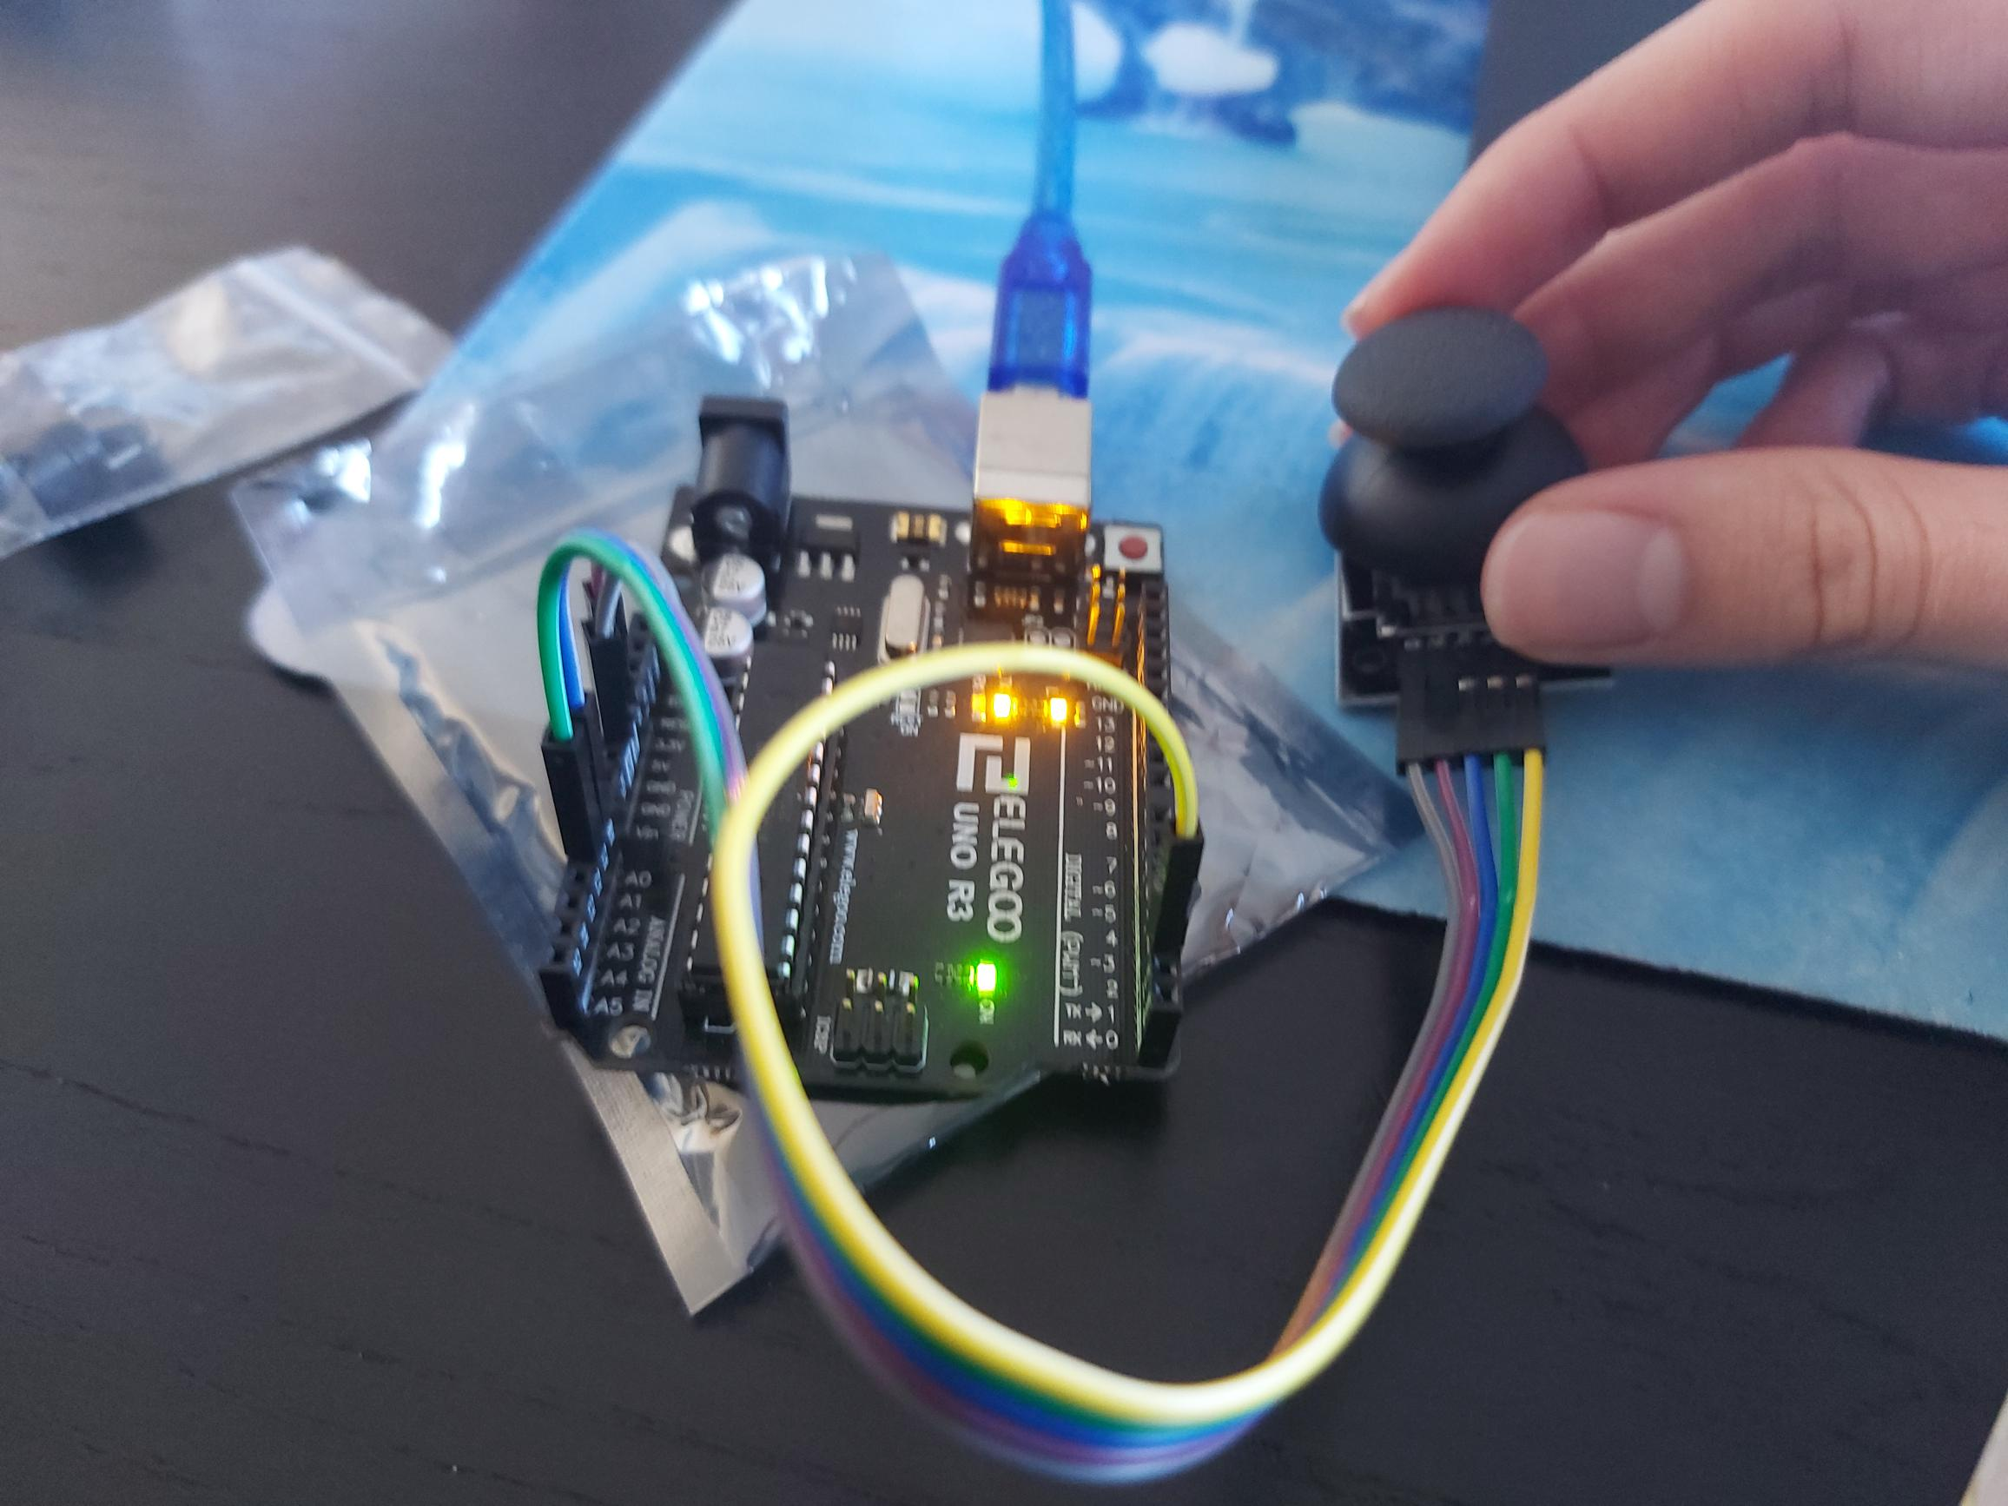
Joystick
Comprises of two potentiometers that act as input variables for the X and Y axes
Comprises of a push switch

Slide 6
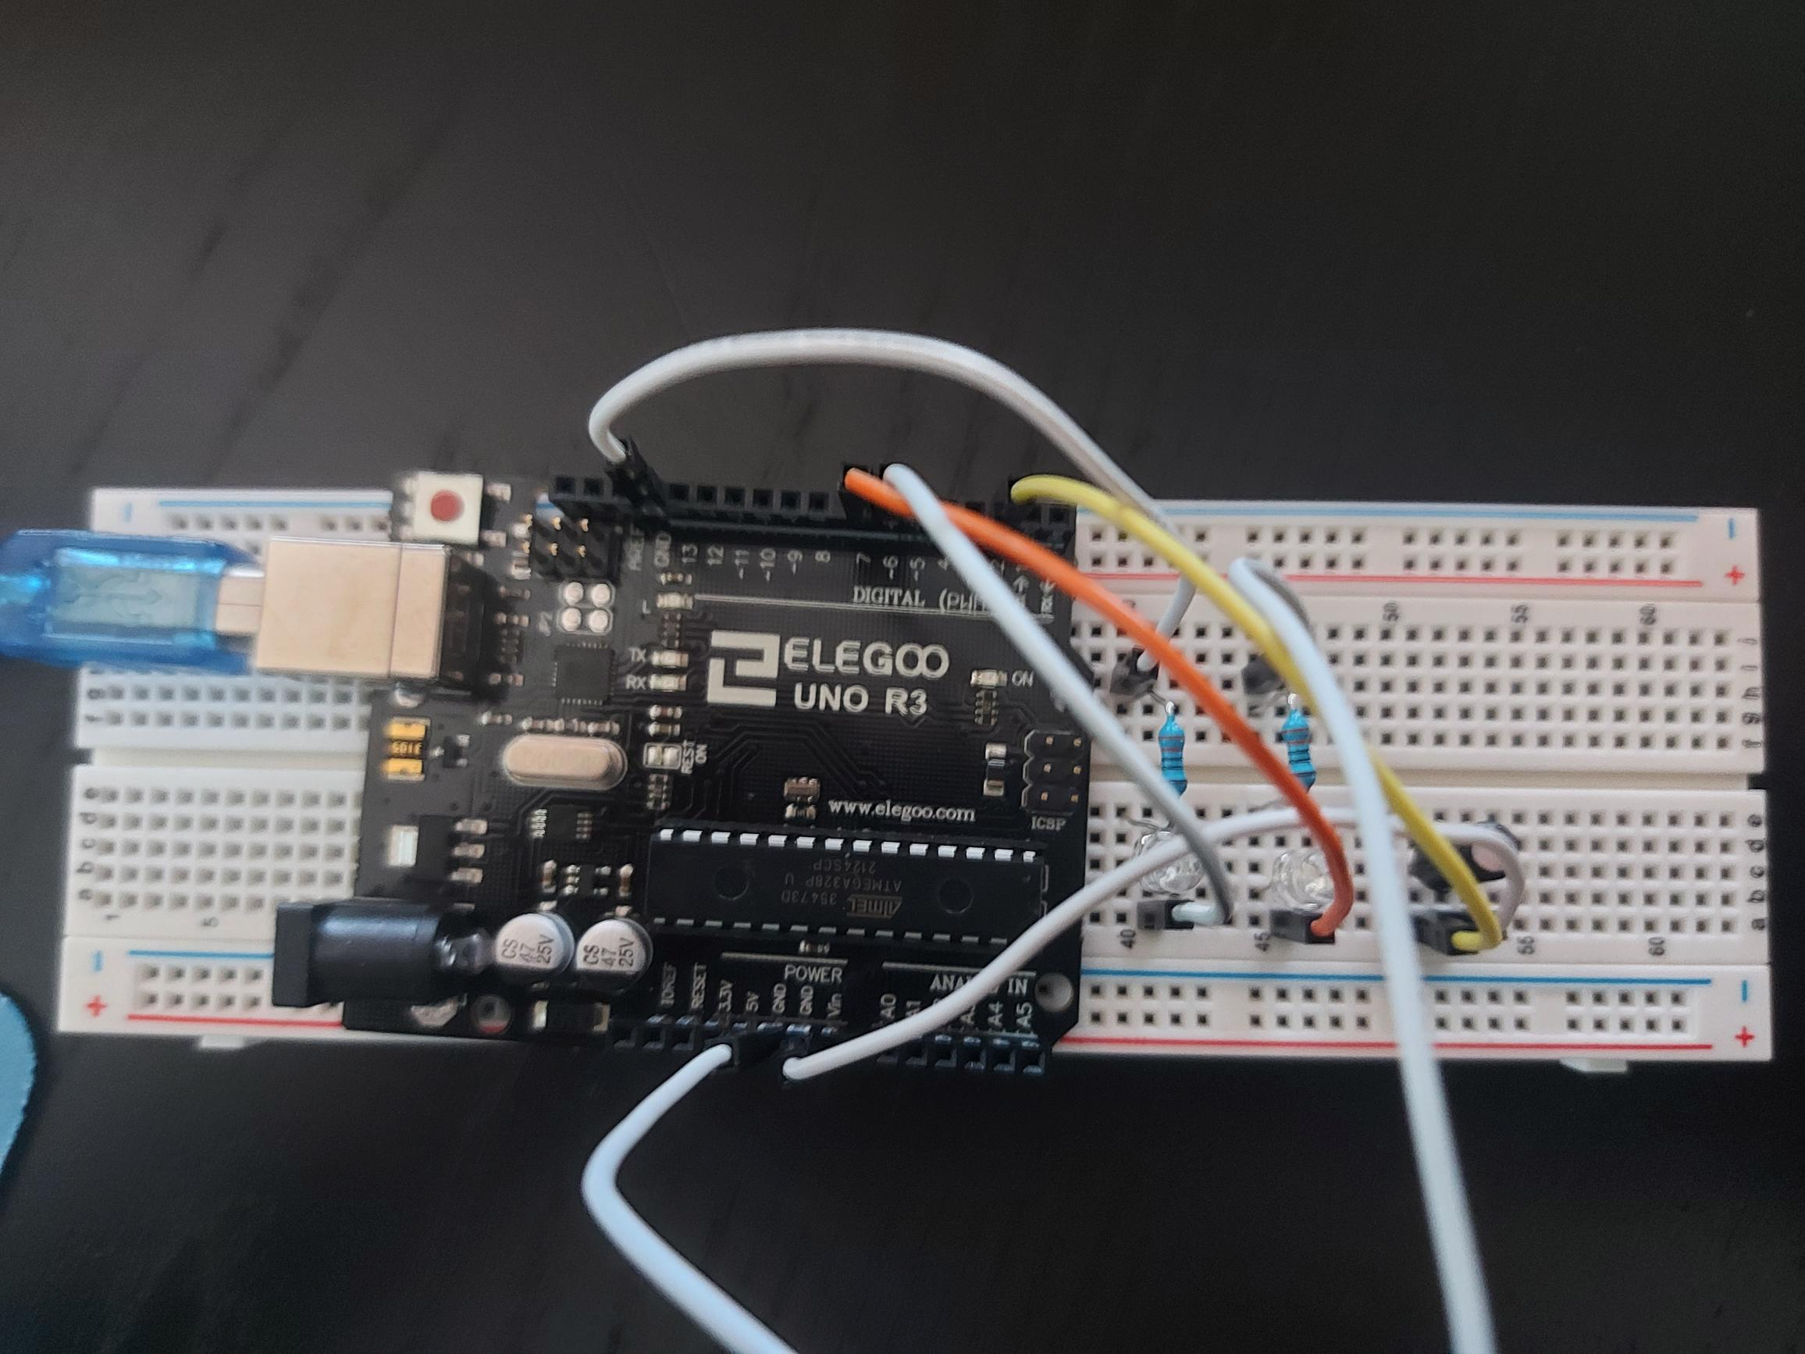
Tilt Switch
Uses tilt switch to control LED to turn on/off when flipped

Slide 7
Task Overview – DC Motor Control
LED Binary Counter:
L293D Motor Controller
DC Motor
Fan Propeller
Power Supply Module
Breadboard
Arduino Uno
Useful tips:
Power Supply positive/negative pins must be correctly inserted into breadboard
Power supply jumper needs to be attached to 5V and VCC, otherwise 5V not supplied
General rule – power and heat management are important – make sure you use controllers and power supplies suited to the motor used in projects

Slide 8
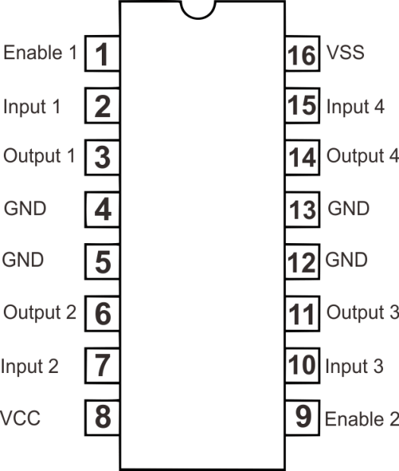
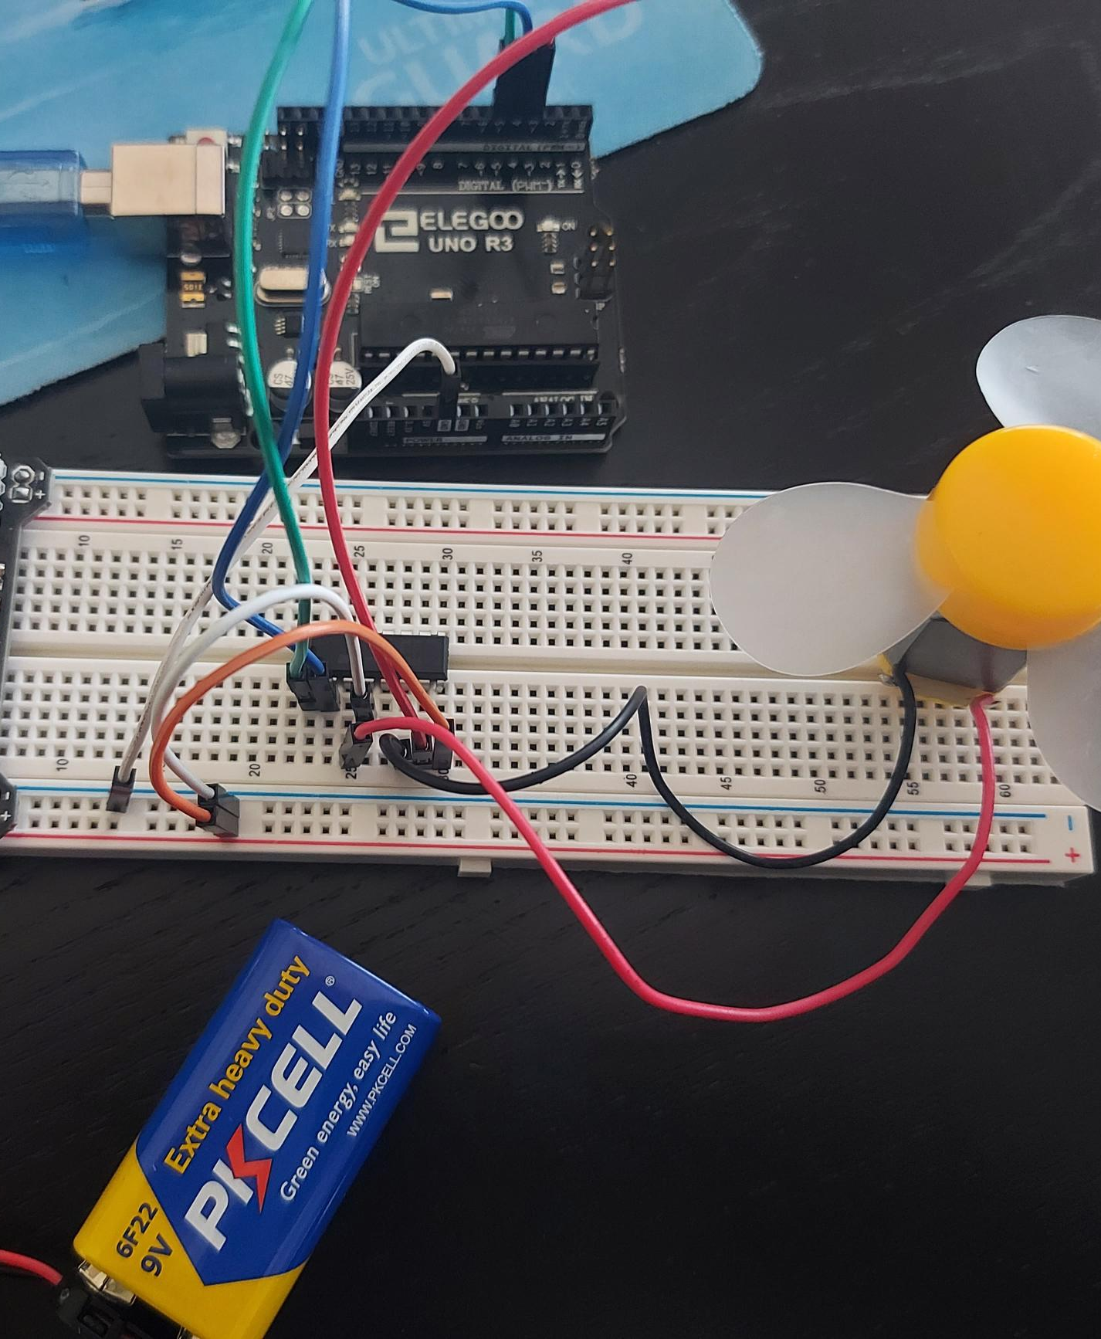
Motor Control Setup
EN1 controls the speed of the motor – use analogWrite to EN1, need squigly line pin to PWM function
IN1 and IN7 control direction
OUT1 and OUT2 connect to the motor
Pin 4 is ground of supply
+Vmotor is power from power supply

Slide 9
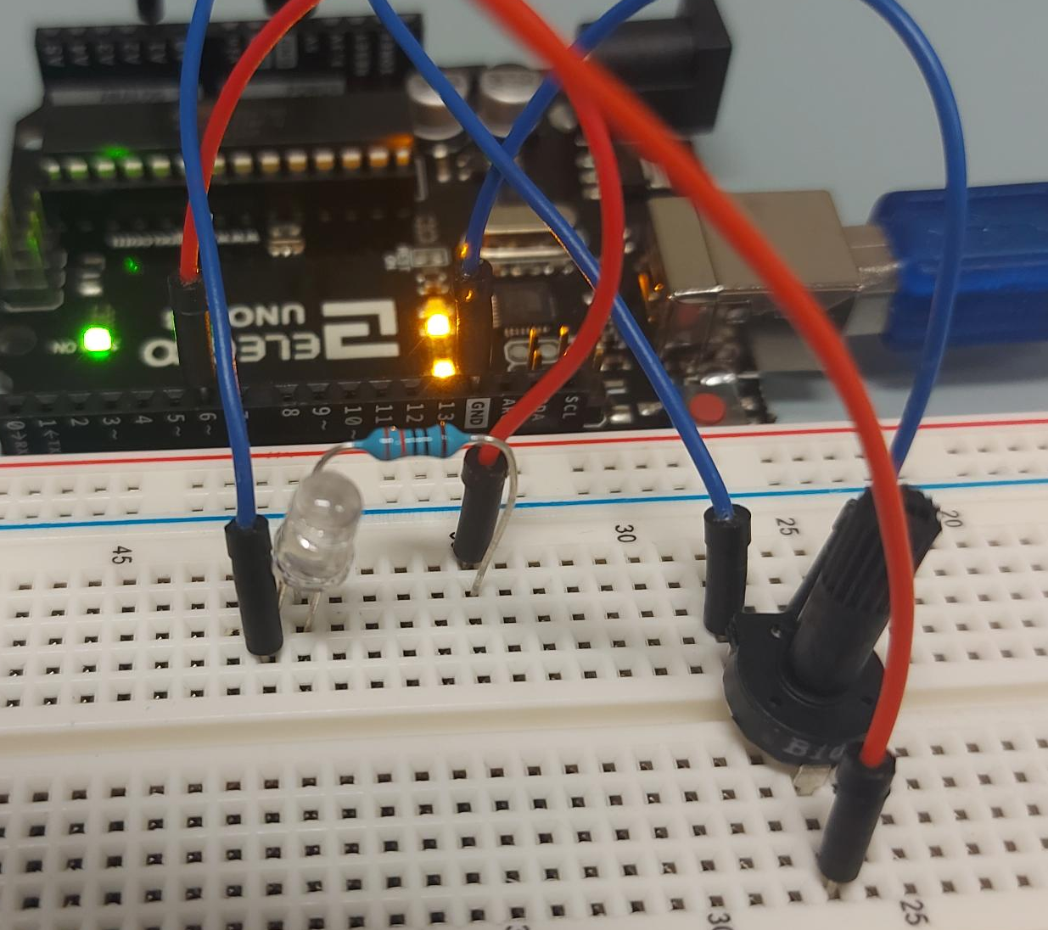
Task Overview – Dimmable LED
(1023,255)
LED Value
Need:
LED
330 Ohm resistor
Potentiometer (variable resistor)
Breadboard
Arduino Uno
Useful tips:
Lead with the Long Leg of the LED
Resistor is positioned opposite to the direction you read it
Potentiometer sends an analog value between 0 – 1023
LED requires an analog write value between 0 – 255
Need an equation to relate the two above statements for the input commands
(0,0)
Potentiometer Value

Slide 10
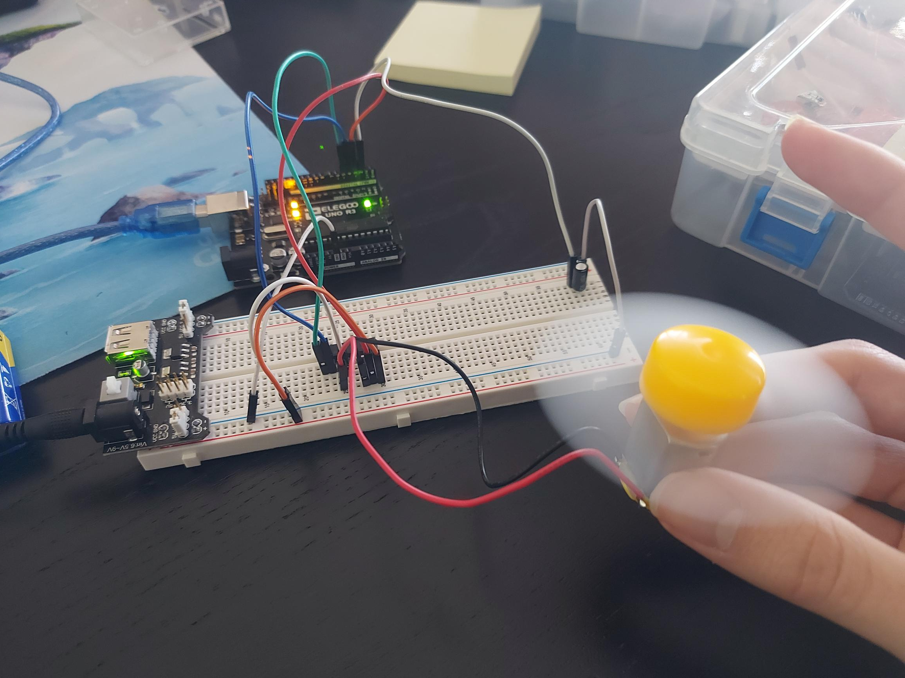
Task Overview – DC Motor Control + Tilt Switch
LED Binary Counter:
L293D Motor Controller
DC Motor
Fan Propeller
Power Supply Module
Breadboard
Arduino Uno
Tilt Switch
Useful tips:
Power Supply positive/negative pins must be correctly inserted into breadboard
Power supply jumper needs to be attached to 5V and VCC, otherwise 5V not supplied
General rule – power and heat management are important – make sure you use controllers and power supplies suited to the motor used in projects

Slide 11
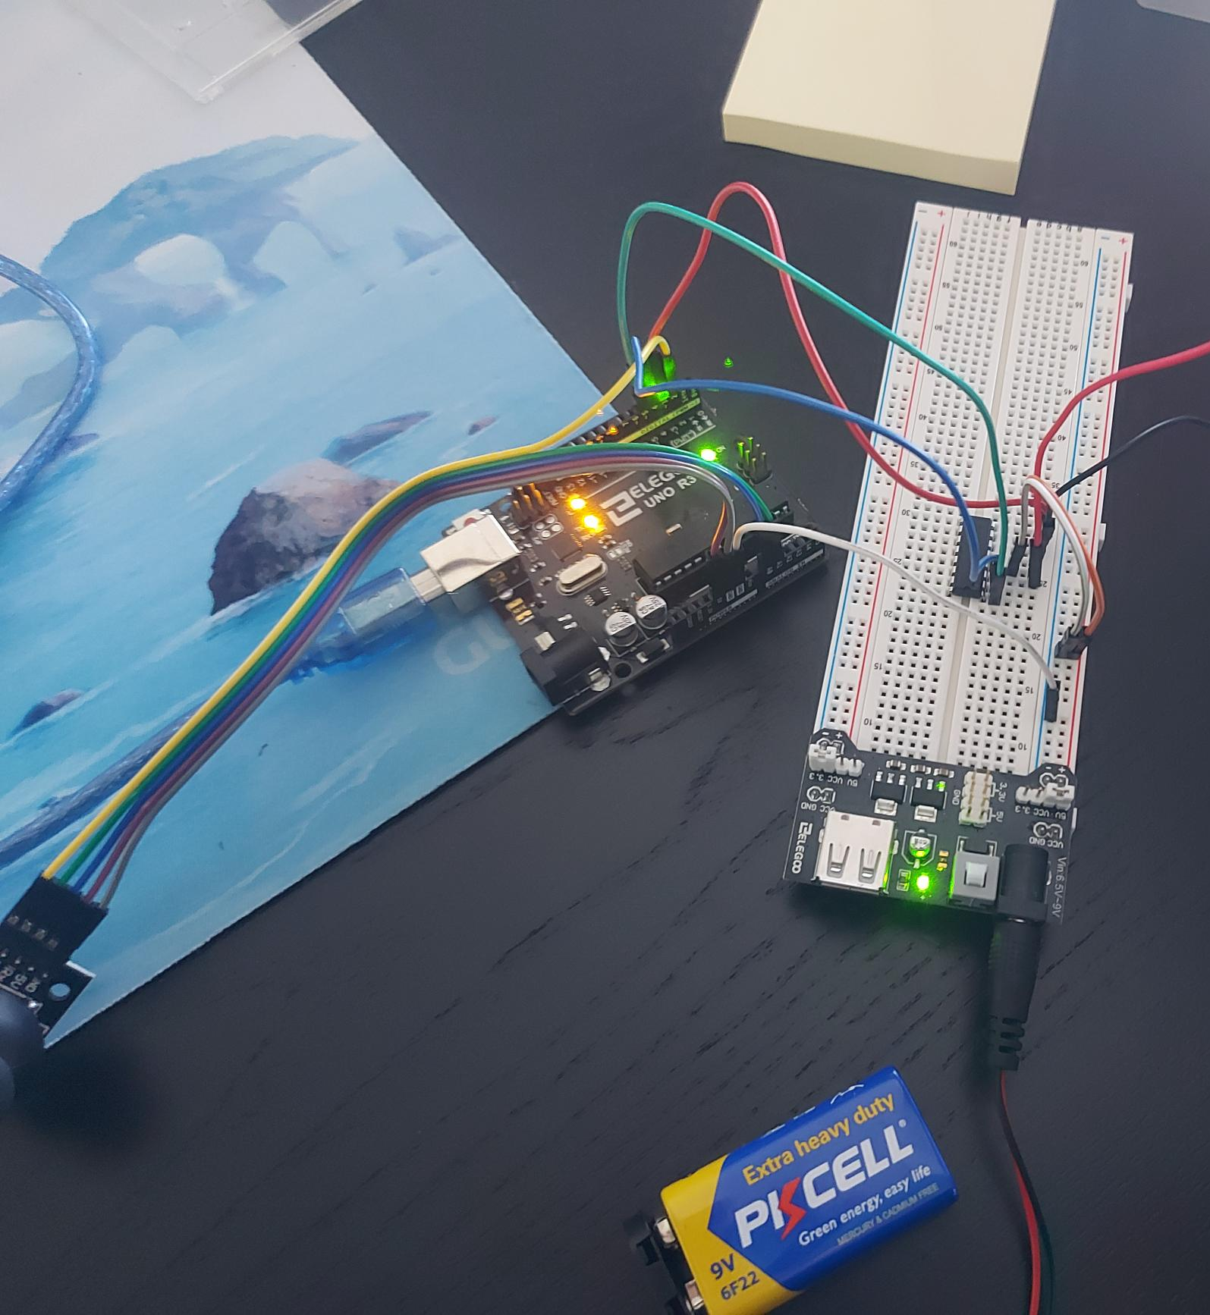
Task Overview – DC Motor Control + Joystick
LED Binary Counter:
L293D Motor Controller
DC Motor
Fan Propeller
Power Supply Module
Breadboard
Arduino Uno
Joystick
Useful tips:
Power Supply positive/negative pins must be correctly inserted into breadboard
Power supply jumper needs to be attached to 5V and VCC, otherwise 5V not supplied
General rule – power and heat management are important – make sure you use controllers and power supplies suited to the motor used in projects

